Slide 1


Slide 2
Repetition Statements
Repetition statements allow us to execute a statement or a block of statements multiple times
Often they are referred to as loops
Like conditional statements, they are controlled by boolean expressions
Java has three kinds of repetition statements:
while
do- while
for
The programmer should choose the right kind of loop statement for the situation

Slide 3
Repetition/Loop Statements
while Loop
do-while Loop
For Loop

Slide 4
The while Statement
A while statement has the following syntax:
If the condition is true, the statement is executed
Then the condition is evaluated again, and if it is still true, the statement is executed again
The statement is executed repeatedly until the condition becomes false
while ( loop-continuation-condition )
statement;

Slide 5
Logic of a while Loop
condition
evaluated
true
false
statement

Slide 6
Loop Design Strategies
Writing a correct loop is not an easy task for novice programmers. Consider three steps when writing a loop.
Step 1: Identify the statements that need to be repeated.
Step 2: Wrap these statements in a loop like this:
while (true) {
Statements;
}
Step 3: Code the loop-continuation-condition and add appropriate
statements for controlling the loop.
while (loop-continuation-condition) {
Statements;
Additional statements for controlling the loop;
}

Slide 7
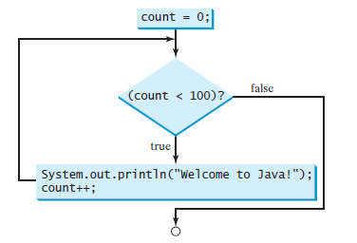
While loop example
The while loop repeatedly executes the statements in the loop body when the loop-continuation-condition evaluates to true.

Slide 8
The while Statement
An example of a while statement:
If the condition of a while loop is false initially, the statement is never executed
Therefore, the body of a while loop will execute zero or more times
int count = 0;
while (count < 2)
{
System.out.println("Welcome to Java!");
count++;
}

Slide 9
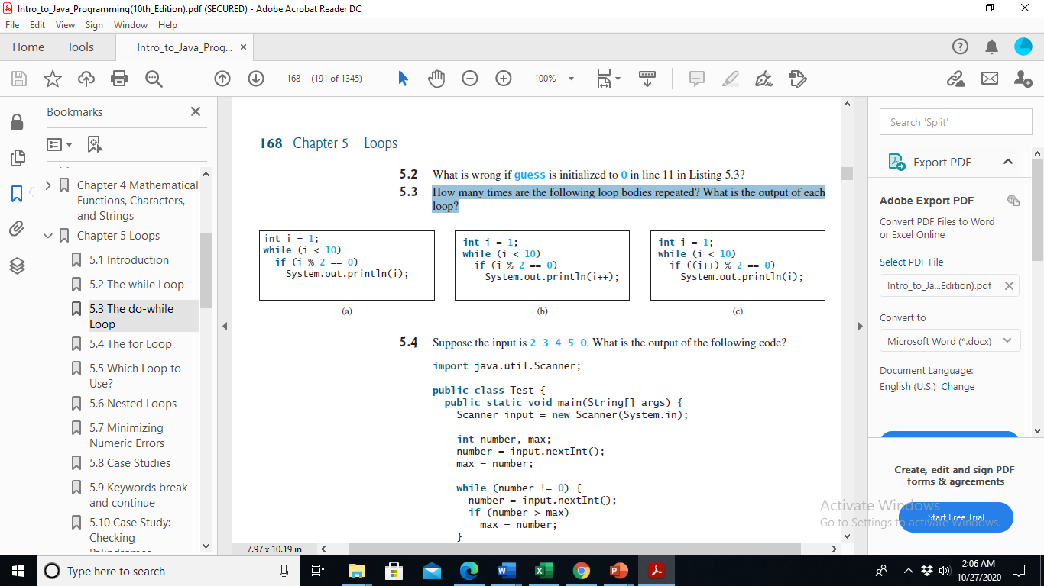
Exercise
How many times are the following loop bodies repeated? What is the output of each loop?

Slide 10
Exercise
Write a program that calculates the average of the numbers from 1 to 10.

Slide 11
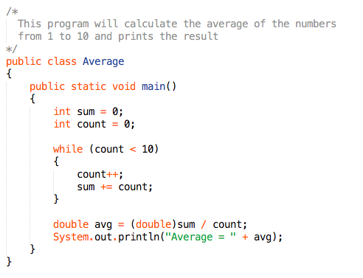
Example (Average.java)

Slide 12
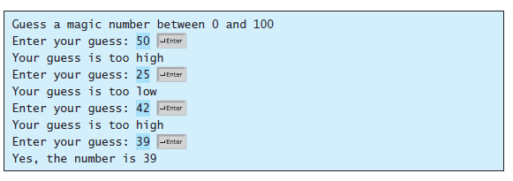
Example: Guessing Numbers
Sample run of the program:
Think before coding
Code incrementally
first write the code for executing the loop one time
then figure out how to repeatedly execute the code in a loop

Slide 13
Writing for single iteration
1 import java.util.Scanner;
2
3 public class GuessNumberOneTime {
4 public static void main(String[] args) {
5 // Generate a random number to be guessed
6 int number = (int)(Math.random() * 101);
7
8 Scanner input = new Scanner(System.in);
9 System.out.println("Guess a magic number between 0 and 100");
10
11 // Prompt the user to guess the number
12 System.out.print("\nEnter your guess: ");
13 int guess = input.nextInt();
14
15 if (guess == number)
16 System.out.println("Yes, the number is " + number);
17 else if (guess > number)
18 System.out.println("Your guess is too high");
19 else
20 System.out.println("Your guess is too low");
21 }
22 }
Now, wrap it up in a loop and look for an appropriate condition

Slide 14
The code
1 import java.util.Scanner;
2
3 public class GuessNumber {
4 public static void main(String[] args) {
5 // Generate a random number to be guessed
6 int number = (int)(Math.random() * 101);
7
8 Scanner input = new Scanner(System.in);
9 System.out.println("Guess a magic number between 0 and 100");
10
11 int guess = -1;
12 while (guess != number) {
13 // Prompt the user to guess the number
14 System.out.print("\nEnter your guess: ");
15 guess = input.nextInt();
16
17 if (guess == number)
18 System.out.println("Yes, the number is " + number);
19 else if (guess > number)
20 System.out.println("Your guess is too high");
21 else
22 System.out.println("Your guess is too low");
23 } // End of loop
24 }
25 }

Slide 15
Infinite Loops
Executing the statements in the body of a while loop must eventually make the condition false
If not, it is called an infinite loop, which will execute until the user interrupts the program
This is a common logical error
You should always double check the logic of a program to ensure that your loops will terminate
Also, check if the loop runs the exact number of times it was intended to (off-by-one errors)

Slide 16
Infinite Loops
An example of an infinite loop:
This loop will continue executing until the user externally interrupts the program.
int count = 1;
while (count <= 25)
{
System.out.println(count);
count = count - 1;
}

Slide 17
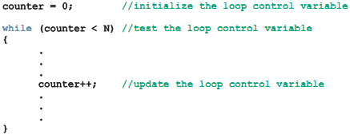
Counter-Controlled while Loops
If you know the number of iterations in advance
Suppose that a set of statements needs to be executed N times
Strategy
set up a counter and initialized to value (e.g zero) int counter = 0;
counter is compared with final value N (counter < N)
Inside the body of the while statement, the value of counter++ increments

Slide 18
/**
* Suppose the input is: * 8 9 2 3 90 38 56 8 23 89 7 2
* Suppose you want to add these numbers and find their average.
* First number e.g. 12 specifies number of values in dataset
* */
import java.util.Scanner;
public class CounterControl{
public static void main(String[] args){
Scanner input = new Scanner(System.in);
int limit;
int number;
int sum;
int counter;
System.out.println("Enter the data for"+
" processing");
limit = input.nextInt();
//initialize counter
counter = 0;
sum = 0;
while (counter < limit){
number = input.nextInt();
sum += number;
counter++;//increment counter
}
System.out.printf("Sum of %d numbers = %d%n",limit,sum);
if(counter != 0)
System.out.printf("The average = %d%n",(sum/counter));
else
System.out.println("No Input");
}
}

Slide 19
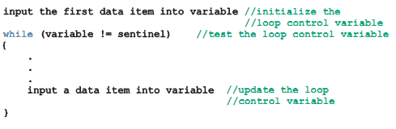
Sentinel-Controlled while Loops
A special value when reading and processing a set of values
Known as a sentinel value, signifies the end of the input
A loop that uses a sentinel value to control its execution is called a sentinel-controlled loop

Slide 20
import java.util.Scanner;
public class Sentinal{
public static void main(String[] args){
Scanner input = new Scanner(System.in);
final int SENTINAL = -999; //some sentinal value
int number;
int sum;
int count;
//initialize counter variable
count = 0;
sum = 0;
System.out.println("Enter the Positive integer"+
"ending with SENTINAL "+SENTINAL);
number = input.nextInt();
_{while (number != SENTINAL){}
_{sum += number;}
count++; //varibale to store total number read
_{number = input.nextInt();}
}
System.out.printf("Sum of %d numbers = %d%n",count,sum);
_{if(count != 0)}
System.out.printf("The average = %d%n",(sum/count));
_{else}
System.out.println("No Input");
}
}

Slide 21
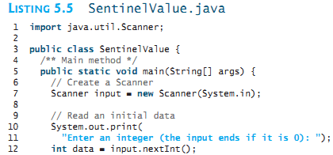
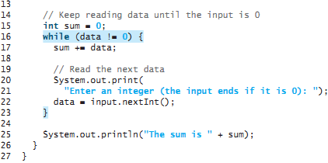

Slide 22
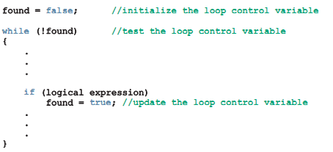
Flag-Controlled while Loops
A flag-controlled while loop uses a boolean variable to control the loop

Slide 23
/**
* guessing a number game
* */
import java.util.Scanner;
public class FlagControl{
public static void main(String[] args){
Scanner input = new Scanner(System.in);
boolean done = false;
int number;
int guess;
number = (int)(Math.random()*100);
while(!done){
System.out.println("Enter the Guess again");
guess = input.nextInt();
if(guess == number){
System.out.println("You guessed Correct Number");
done = true;
}
else if(guess < number){
System.out.println("Too Low");
}
else
System.out.println("Too high");
} } }

Slide 24
import java.util.Scanner;
public class FlagControl{
public static void main(String[] args){
Scanner input = new Scanner(System.in);
boolean done = false;
int number;
int guess;
int noOfGuesses = 0;
number = (int)(Math.random()*100);
while((noOfGuesses <5) && (!done)){
System.out.println("Enter the Guess again");
guess = input.nextInt();
noOfGuesses ++;
if(guess == number){
System.out.println("You guessed Correct Number");
done = true;
}
else if(guess < number){
System.out.println("Too Low");
}
else
System.out.println("Too high");
} } }
// After Five tries
if(!done)
System.out.println("You loose! The correct " + "number is: "+number);

Slide 25
Checking Numeric Ranges with Logical Operators
To determine whether a numeric value is within a specific range of values, use &&
Example: while (x >= 10 && x <= 20){…}
To determine whether a numeric value is outside of a specific range of values, use ||
Example: while (x < 10 || x > 20){…}

Slide 26
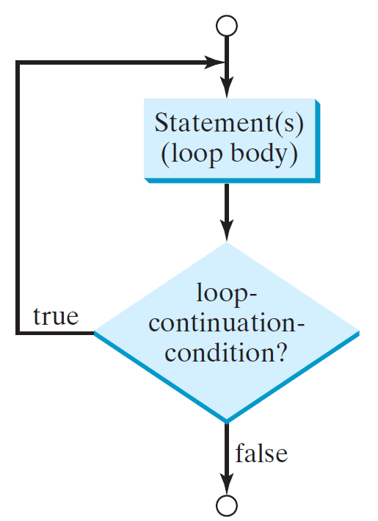
do-while Loop
A do-while loop is the same as a while loop except that it executes the loop body first and then checks the loop continuation condition.
do {
// Loop body;
Statement(s);
} while (loop-continuation-condition);

